Slide 1
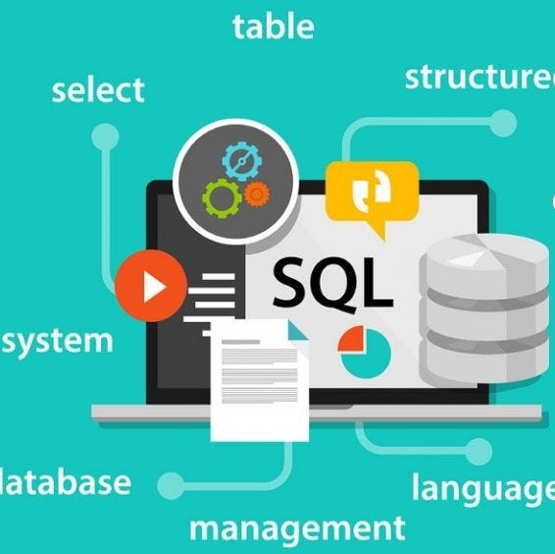
Essential SQL Concepts & Reporting
Prepared by:
Shobhita Sohal

Slide 2

Project Objective
Part1 - This project involves performing advanced analytics on the provided dataset using SQL to derive actionable insights. The analysis includes:
Trend & Seasonality Analysis – Examining sales patterns over time to identify trends and seasonal fluctuations across different product categories and subcategories.
Performance Benchmarking – Assessing sales, product performance, and customer acquisition against predefined benchmarks or targets.
Market Share & Contribution Analysis – Identifying which product categories, subcategories, or price ranges contribute the most to overall sales.
Data Segmentation – Categorizing data (e.g., customer age groups, product performance tiers, or pricing bands) to uncover key insights into customer preferences and product demand.
The insights gained from these analyses support data-driven decision-making and enable the creation of impactful visualizations for stakeholders.
Part 2 - As a final deliverable, sales trend reports and product performance summaries were generated and shared with the customer. These reports can be visualized using Tableau or Power BI or delivered as SQL views

Slide 3

Part 1 – Essential Analytics Concepts

Slide 4
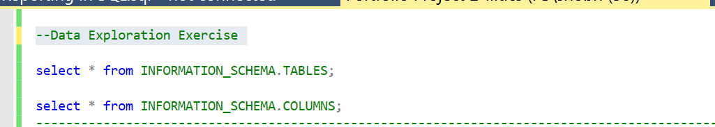
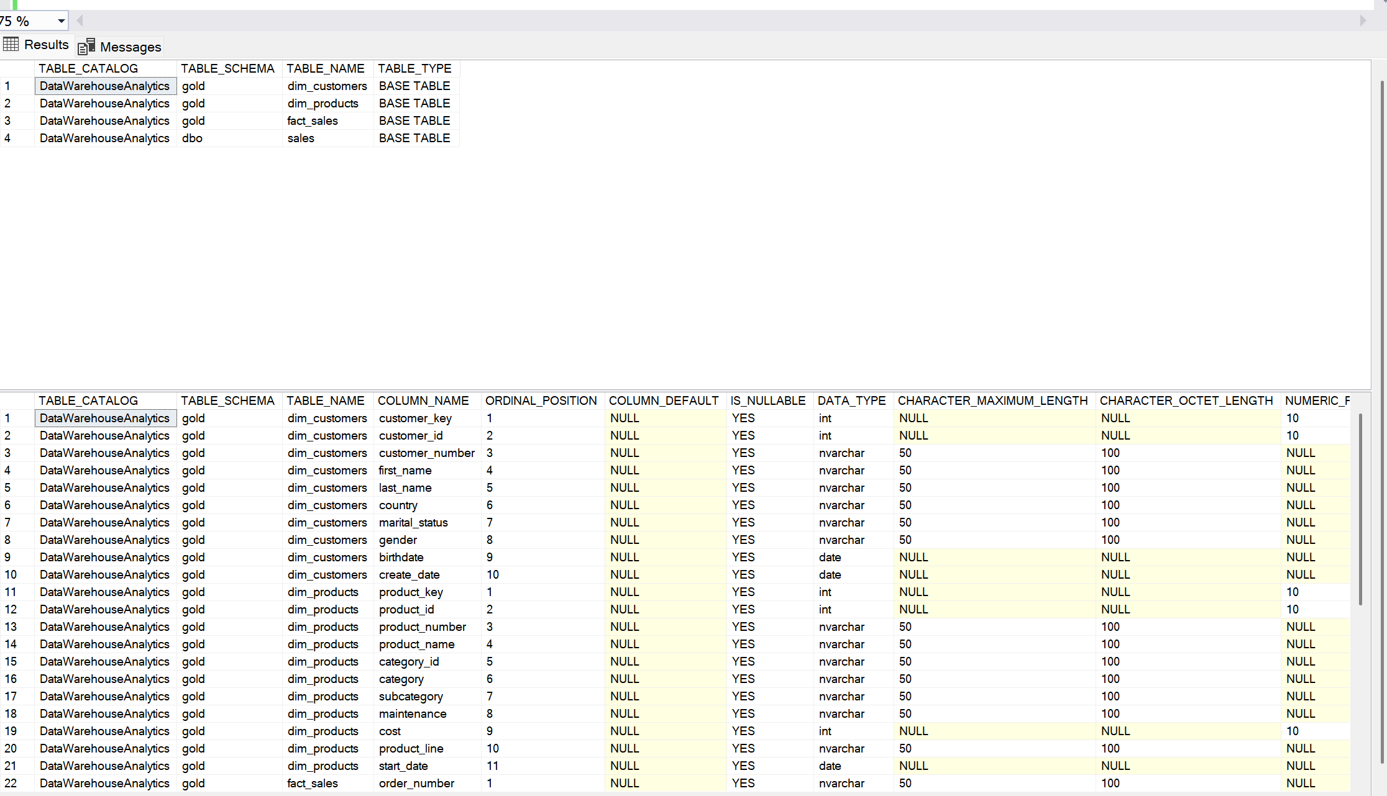
Data Exploration
Before data analysis we need to understand the data tables to performance any analysis .
There are 2 dimensions table and 1 table with measures to perform analysis.
Dimensions Table– Dimensions table contains information where aggregations cannot be applied such as customers and products.
Measures Table – Measures table contain information which can be aggregated to measure business performance and draft strategies. Such as sales, price, cost etc.

Slide 5
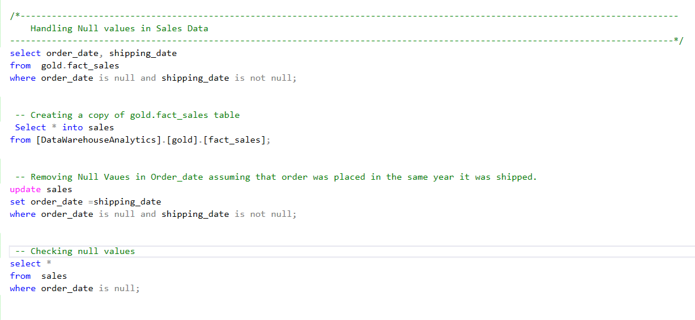
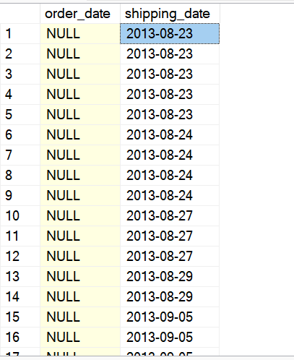
Data Exploration
To perform aggregations on sales table, a copy of table has been created so that the original data is not altered.
Null values .in the order_date column were replaced with Shipping date with an assumption that shipping was done in the same as it the order was placed. Also, the month is not December and the average number of days taken to ship order is 7 days. Therefore, it is safe to replace null values with shipping_date or 7 days before the shipping date.

Slide 6
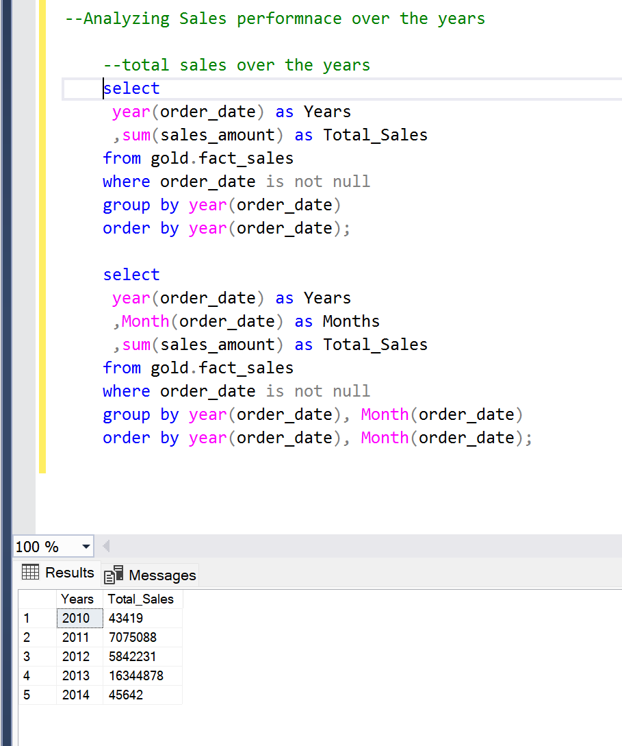
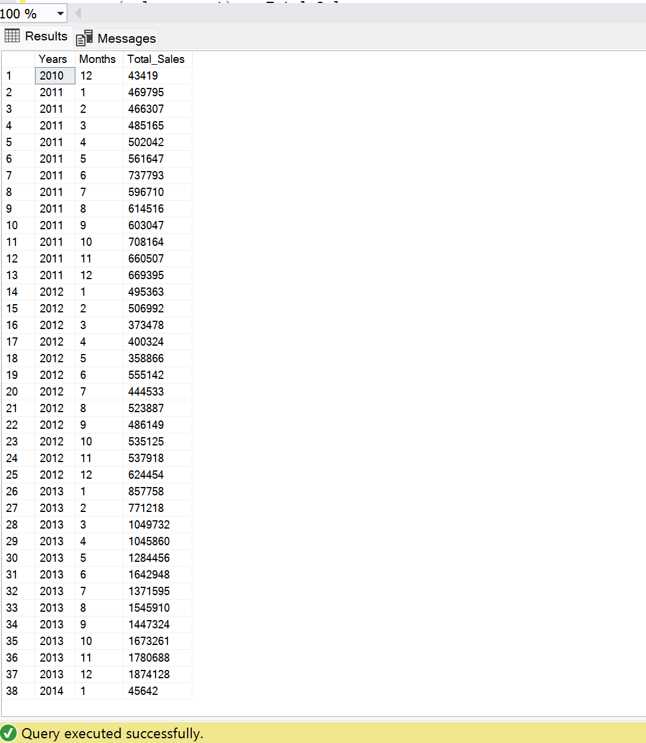
1. Trend & Seasonality Analysis
In this section, trends and seasonality over time in data will be checked, such as analyzing sales performance over time-
Total sales over the years,
Total sales by month (Reflecting seasonality)
When aggregating data by the year, 2014 sales are too low. Upon checking the data further by drilling down to months and we have 2 outliers that may give misleading insights.
For 2010, we have data only for December month. Similarly, for 2014, we have data only for January.
Monthly view of data also shows that sales are increasing from October to December (Q4) as slows down again from Jan -Mar (Q1), reflecting seasonality in the data.

Slide 7
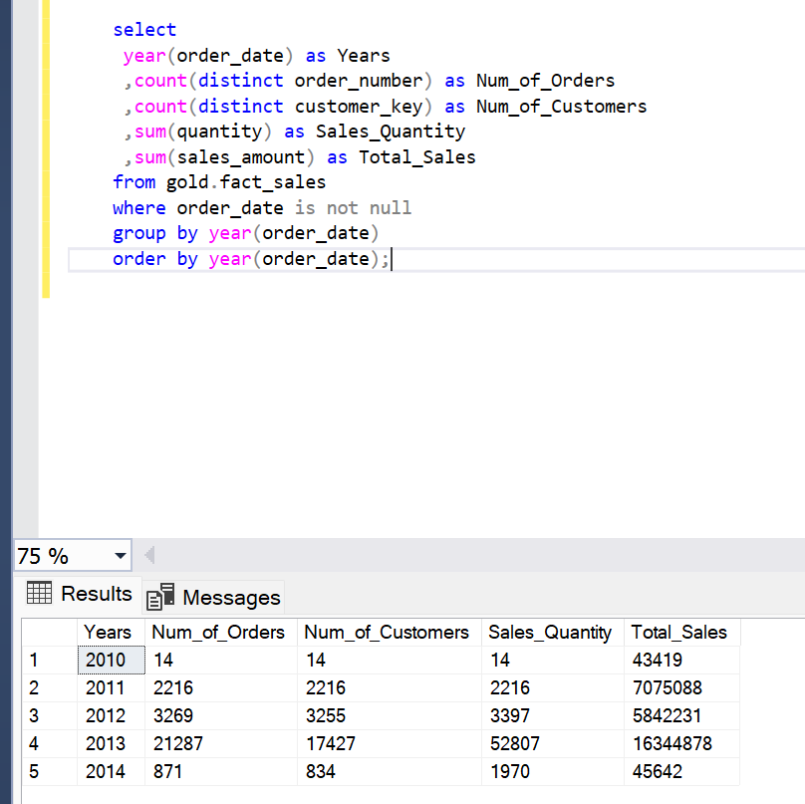
1. Trend & Seasonality Analysis
High level overview of data shows that customers and sales have increased overtime and customers have been purchasing multiple items, compared to sales in 2011.

Slide 8
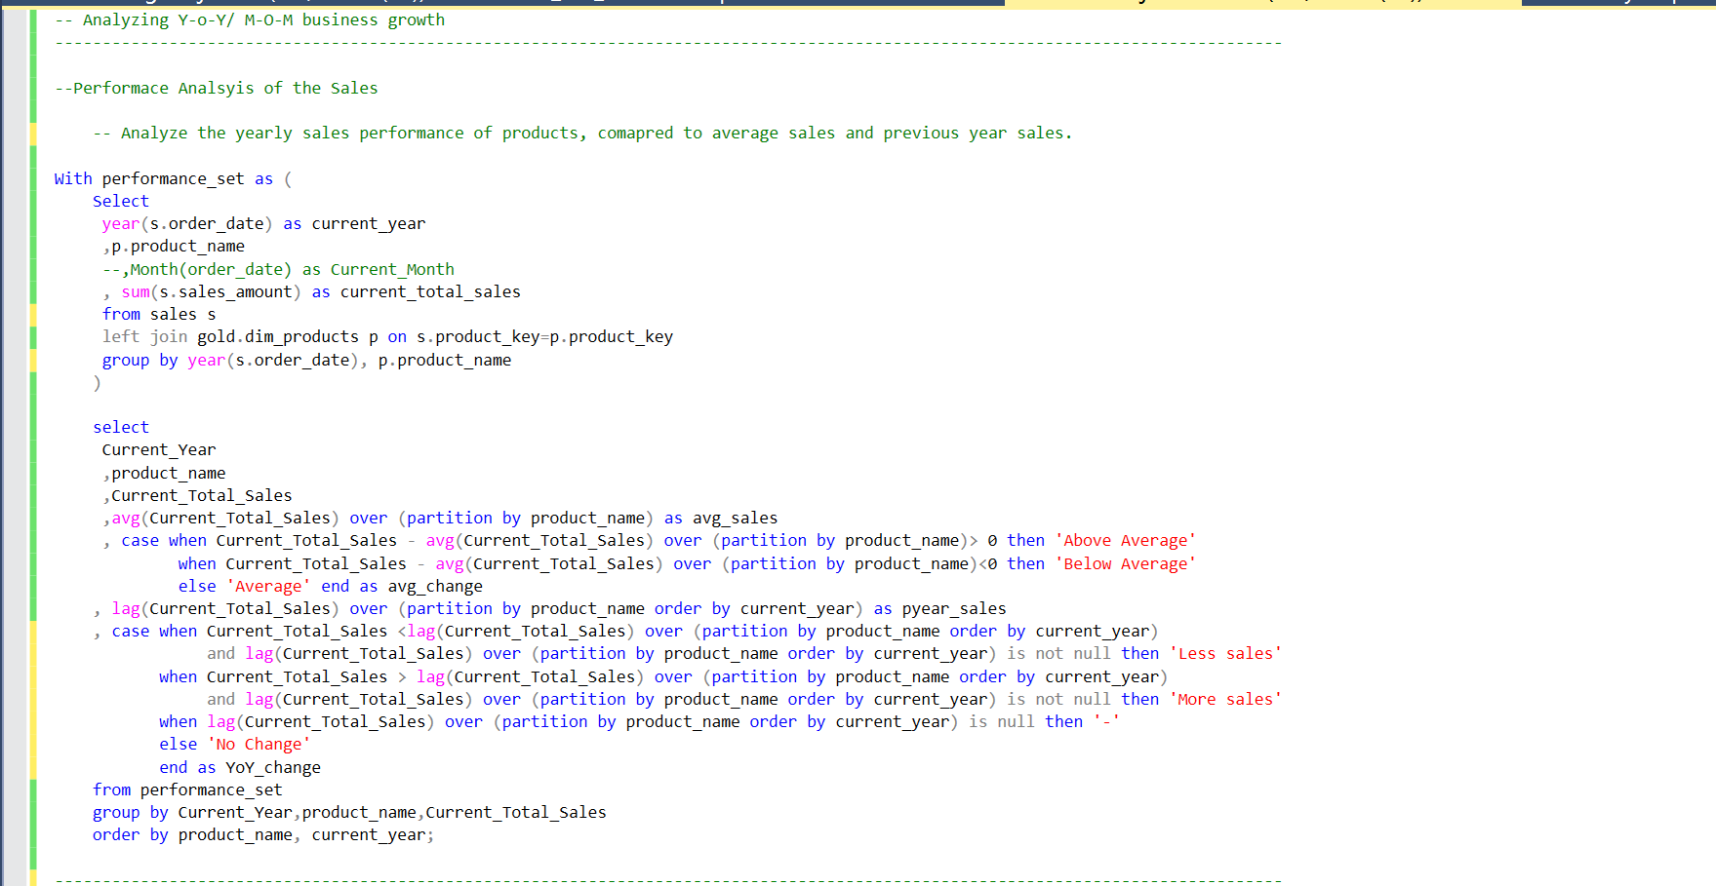
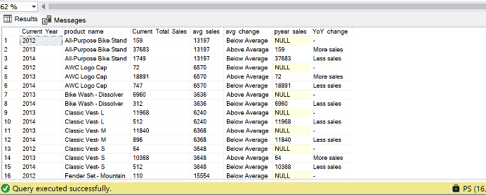
2. Performance Analysis
In this section, comparison of the current data with a target value has been performed to understand the performance of business so that strategies must be developed to reach the target and also understand which strategies worked for the business.
Below is the data output analyzing the performance of different products, compared to average sales and previous year sales.
Using Similar approach, we can calculate m-o-m change in sales, customers, or compare against the yearly targets etc.

Slide 9
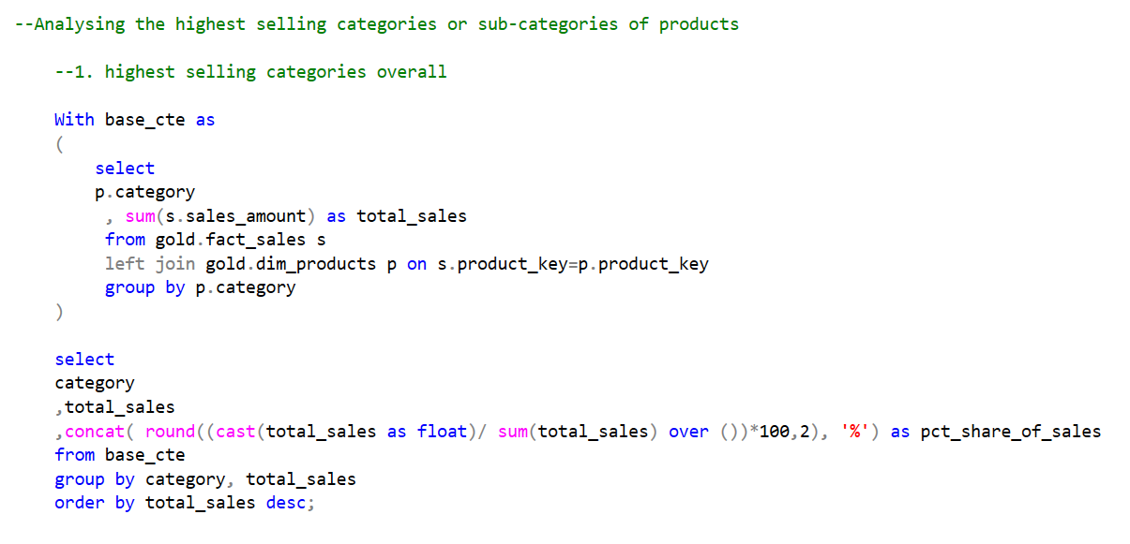
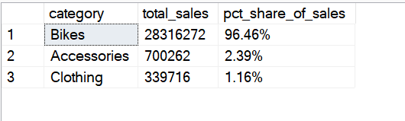
3. Market Share & Contribution Analysis
Depending on the level of granularity requested by the business or client, following analysis can be conducted –
Highest selling category of products by share.
Highest selling category of products Y-o-Y and their respective share in each year
Category of products gaining more customers Y-o-Y.

Slide 10
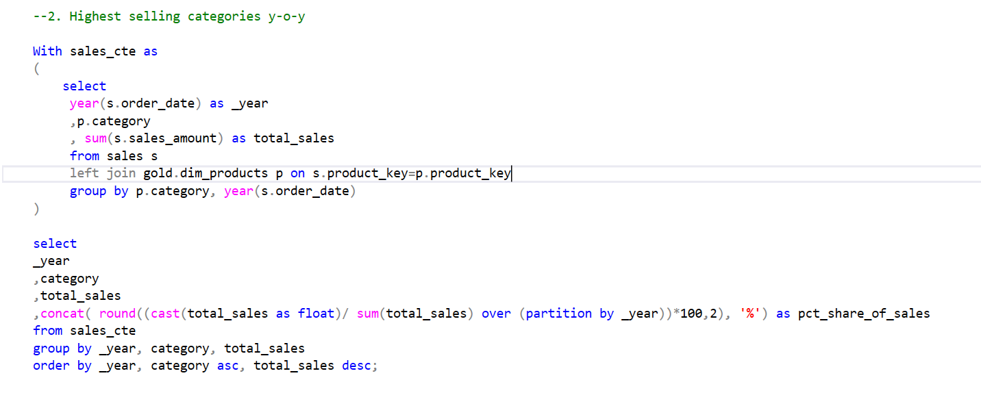
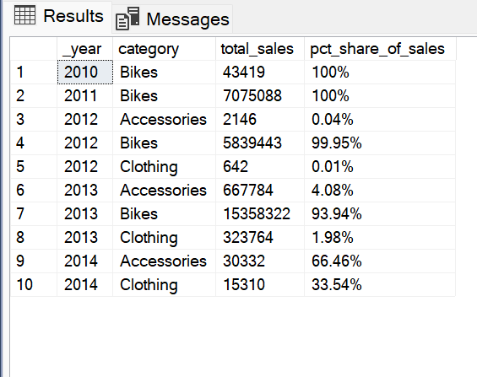
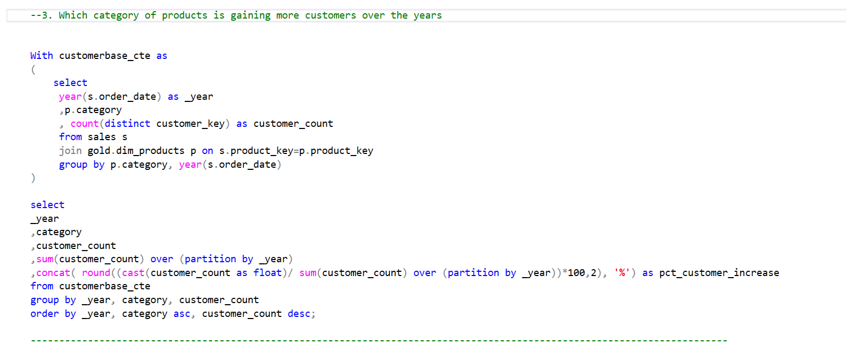
3. Market Share & Contribution Analysis

Slide 11
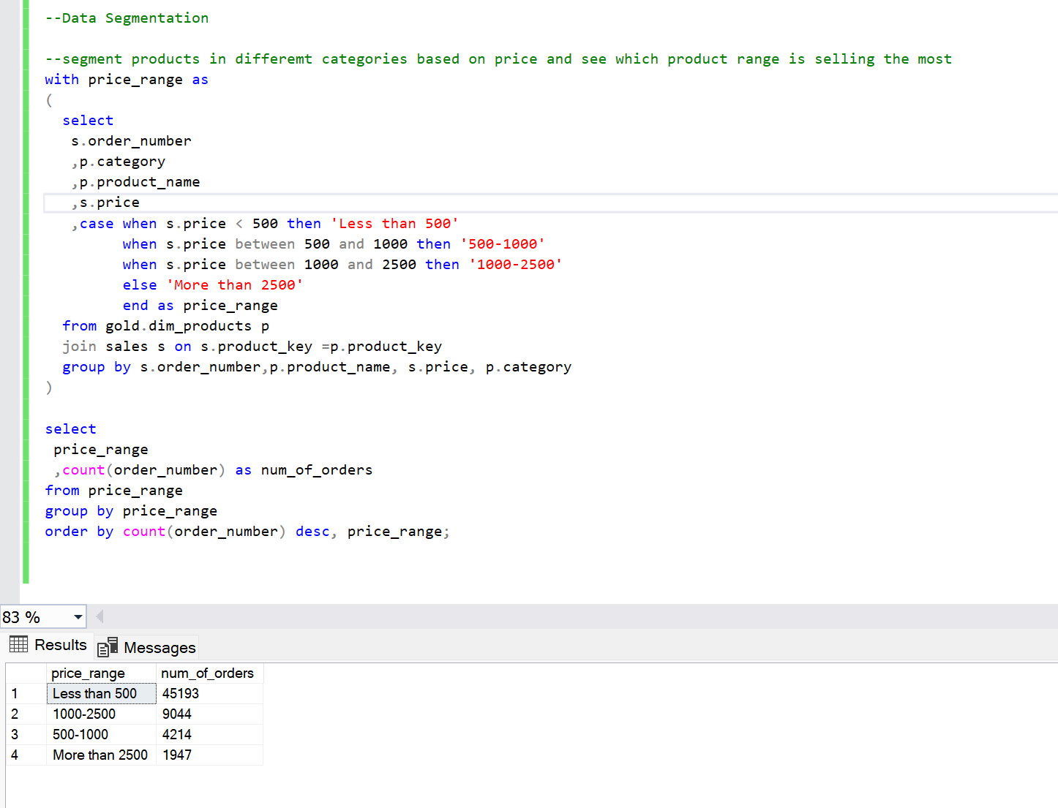
4. Data Segmentation
Data has been segmented into different price ranges to understand which price range is frequently bought or ordered by customers.
Granularity of the data can be increased as per the request such as to explore which categories under these price ranges are ordered the most or what is the product name.
Example 1- segment the products inro different categories to understand the popular price range among shoppers.

Slide 12
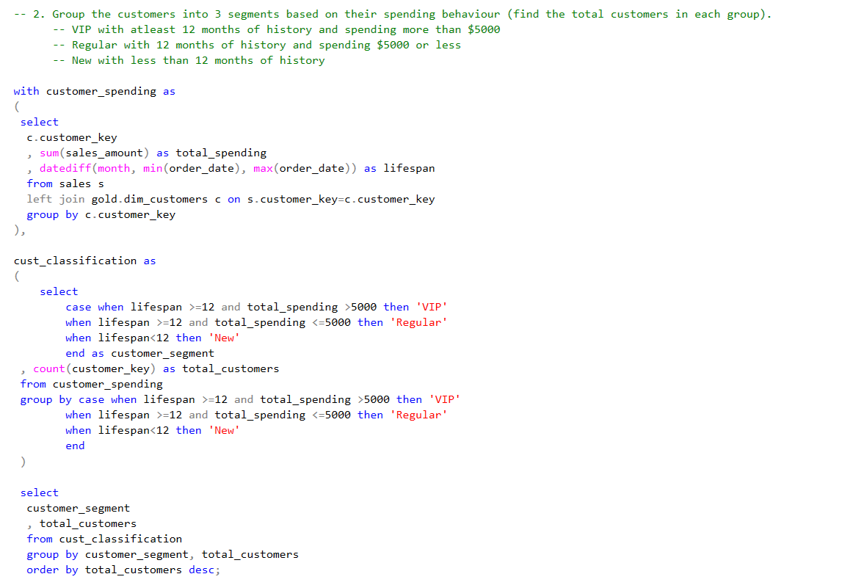
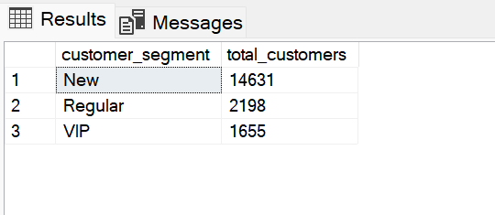
4. Data Segmentation
Example 2- Creating customer segmentation based on their spending behaviour.

Slide 13

Part 2 – Reporting on Sales & Products

Slide 14
Task 1- Customer Behavior Analysis and Reporting
Purpose:
This project aimed to consolidate key customer metrics and behaviors to provide actionable insights for business decisions.
Problem Statement/Business Context:
The business question we are trying to answer through this exercise include:
Understanding our customer base better to tailor marketing efforts.
Identifying high-value customers for targeted loyalty programs.
Gaining insights into customer engagement and spending patterns.
Monitoring customer acquisition and retention trends.
Data Sources and Tools
SQL Server was the primary tool for data extraction, transformation, and analysis to generate this report.
The key tables used to extract data are sales and customer table.

Slide 15
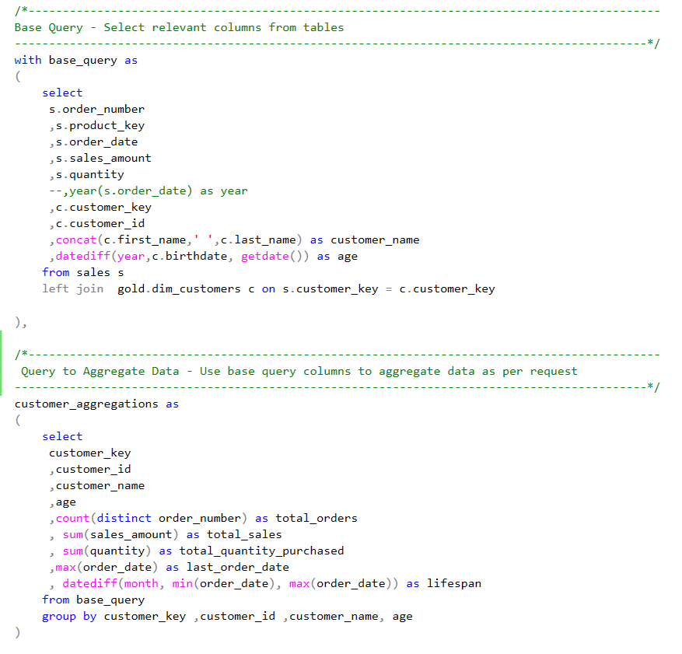
Task 1- Approach
To build the report, I used SQL Server and developed a series of queries to retrieve and aggregate customer data from the sales and customer tables. I followed a multi-step approach to break down the data and derive the required metrics.
Base Query CTE:
The first step was creating a base query that joins the sales table and the dim_customers table to get the essential fields. This included customer names, transaction details, and calculating customer age based on their birthdate."
Ensured that most relevant columns are selected such as order number, product key, sales amount, and quantity, along with customer key and ID for later aggregation.

Slide 16
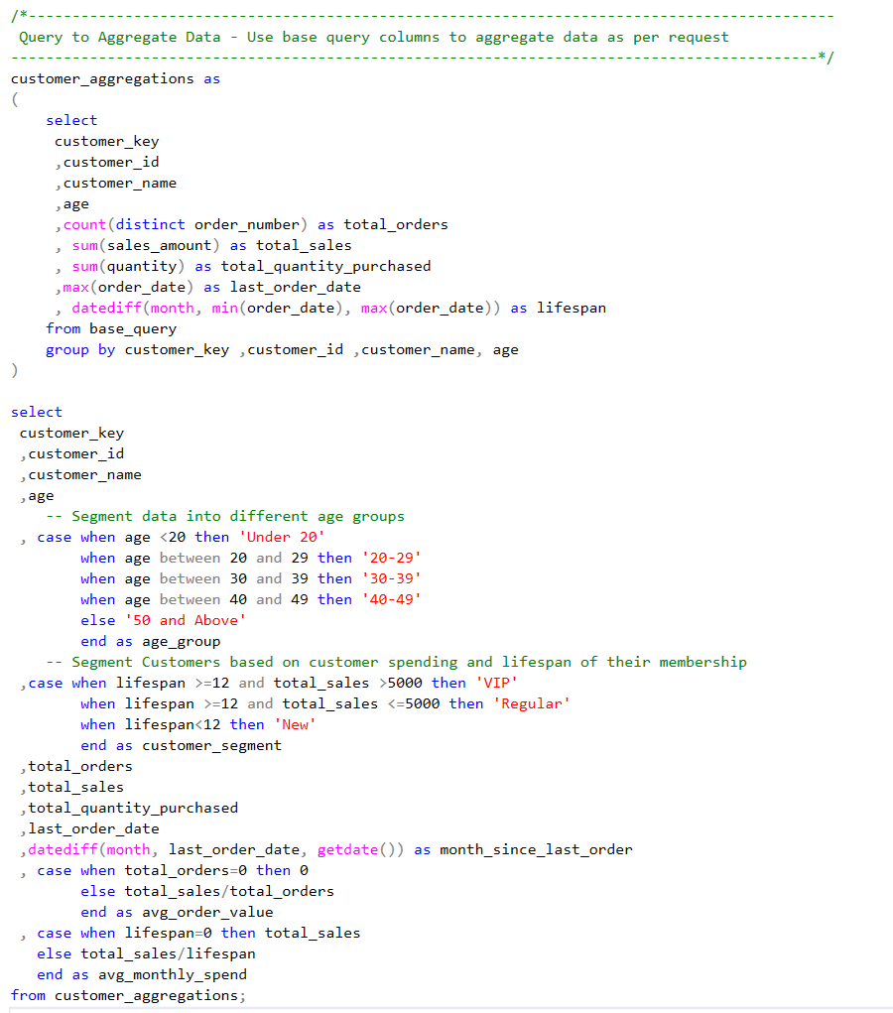
Task 1- Approach
Aggregations CTE :
Created another CTE for aggregation of relevant columns that grouped data by customer_key, calculating the following:
Total number of orders made by the customer
Total sales and quantity purchased
The customer’s lifespan, which was calculated as the difference between the first and most recent order date.
Segmentation and KPI Calculation
Used the aggregated data to segment the customers into three groups:
VIP: Customers with a lifespan greater than 12 months and sales over $5,000.
Regular: Customers with a lifespan greater than 12 months but with sales of atleast $5,000.
New: Customers who have made purchases within the last 12 months.

Slide 17
Task 1- Approach
Following KPIs were calculated as requested in the report-
Recency: The number of months since the customer’s last order.
Average Order Value (AOV): Total sales divided by the number of orders.
Average Monthly Spend: Total sales divided by the customer’s lifespan in months.
Key Elements in the Query:
Common Table Expressions (CTEs): Used CTEs to break the problem into logical components: first, the base_query to gather raw transaction data and customer information; then, the customer_aggregations CTE to perform the necessary aggregations for total orders, sales, and lifespan.
Segmentation Logic: For segmentation, CASE statements to categorize customers based on their age and their purchasing behavior (sales and lifespan).
Date Calculations: DATEDIFF function was used to calculate the customer lifespan and the time since their last order.

Slide 18
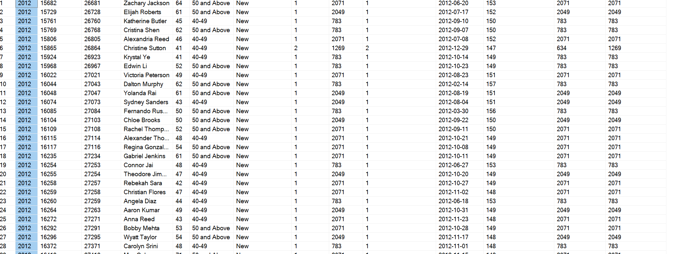
Task 1 - Final Output
The final output of the first report can be saved as csv to be used in visualization tools such as PowerBI or Tableau.
Alternatively, a view can be created for the relevant team who is responsible for monitoring this data month-on-month and year-On-year for strategic decision making.

Slide 19
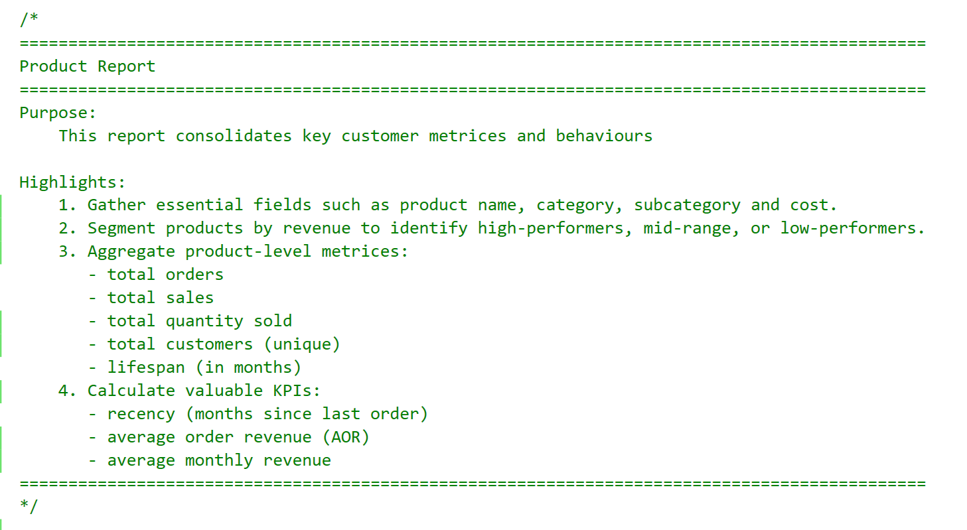
Task 2- Product Performance Analysis and Reporting
Purpose:
This project involved creating a comprehensive 'Product Report' designed to help businesses understand which products are driving revenue, identify customer behavior patterns related to products, and ultimately inform strategic decisions around product development, marketing, and inventory management.
Problem Statement/Business Context:
The business question we are trying to answer through this exercise include:
Identify top-selling and underperforming products based on revenue earned in each category.
Understand which products attract the most customers and have the highest order frequency.
Analyze the product orders by category and identify purchase trends over time.
Evaluate the average selling price vs cost to understand profit margins and adjust prices if needed.
Compare product performance within their respective categories to identify relative strengths and weaknesses.

Slide 20
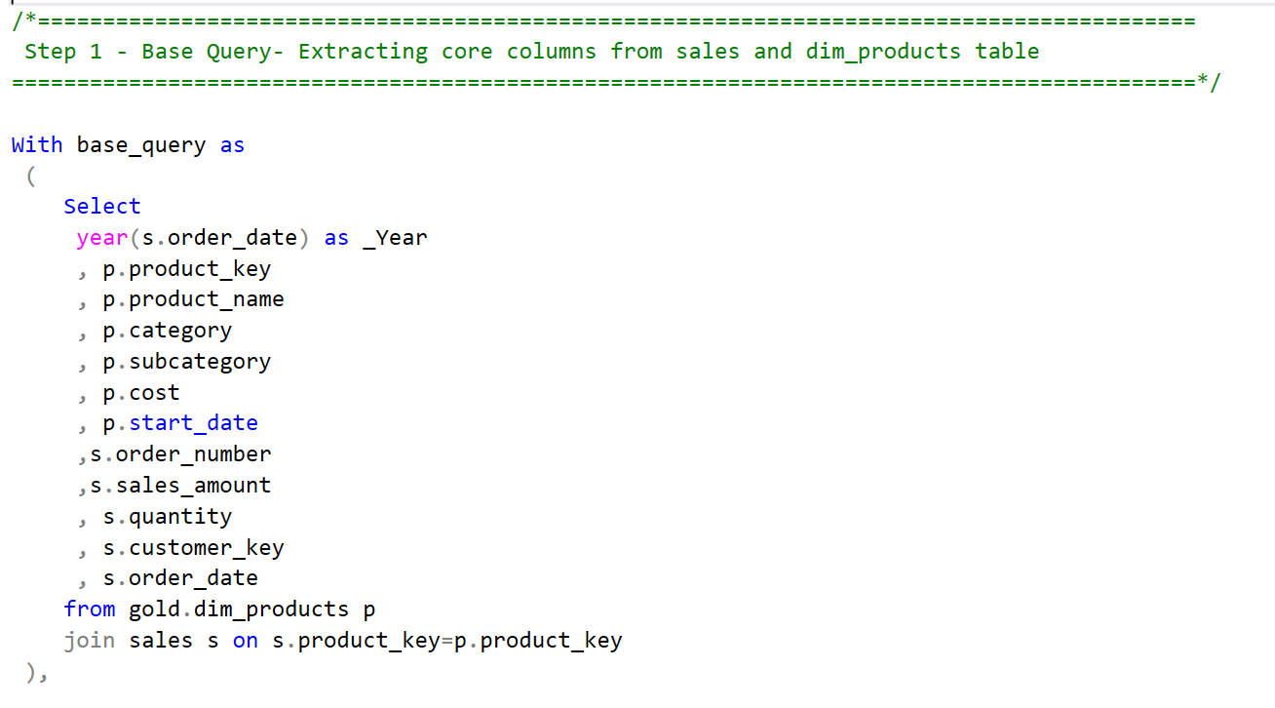
Task 2- Approach
To build the report, SQL Server was used to develop a series of queries to retrieve and aggregate product and sales data from respective tables. A multi-step approach was followed to break down the queries into two different CTEs to calculate KPIs and extract the required metrics before finalizing the query.
Base Query CTE:
The first step was creating a base query that joins the sales table and the dim_products table to get the essential fields. dim_products (which contains product details) and sales (which holds transaction-level sales data)
Ensured that most relevant columns are selected such as order year, product details (key, name, category, subcategory, cost), sales transaction details (order number, sales amount, quantity, customer key, order date).for later aggregation.

Slide 21
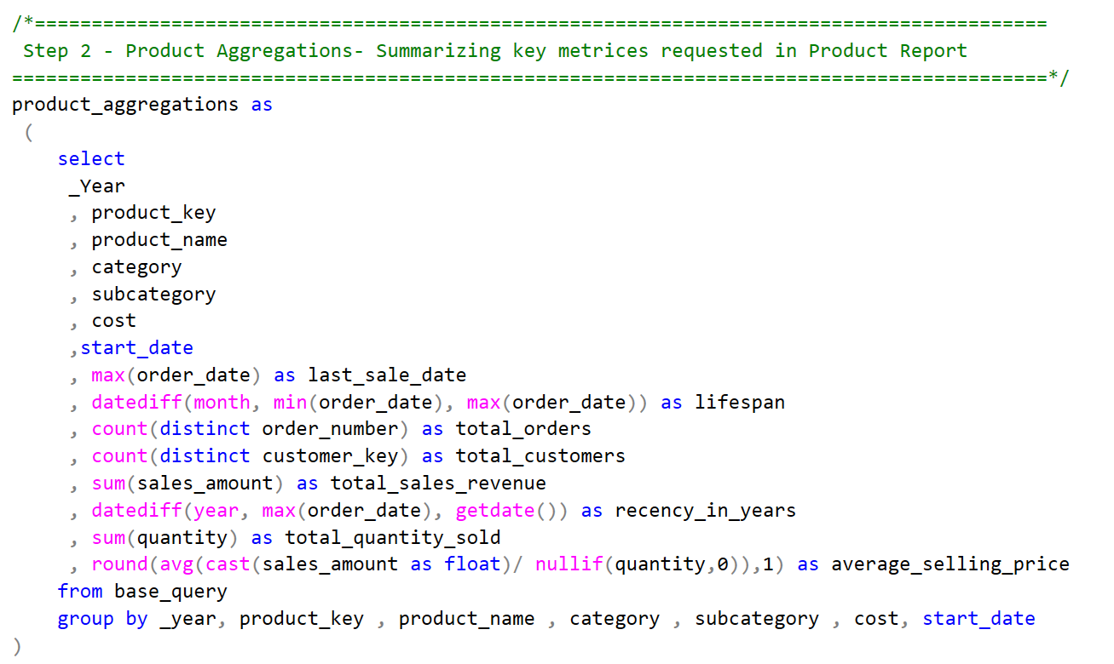
Task 2- Approach
Aggregation CTE- Summarizing Key Metrics
Once the base data is obtained in base CTE, the next step is to aggregate the data to calculate important metrics for each product. These metrics will help us assess product performance in a structured way. We calculate:
Lifespan: The time span between the first sale and the most recent sale.
Total Orders: The total number of orders for the product.
Total Sales Revenue: The sum of sales amount for the product.
Recency in Years: The number of years since the last sale was made.
Total Quantity Sold: The total quantity of units sold.
Average Selling Price: The average price at which the product was sold, calculated as sales amount divided by quantity.
We achieve this by grouping the data by product key, along with other product attributes like category and subcategory, and then applying aggregate functions.

Slide 22
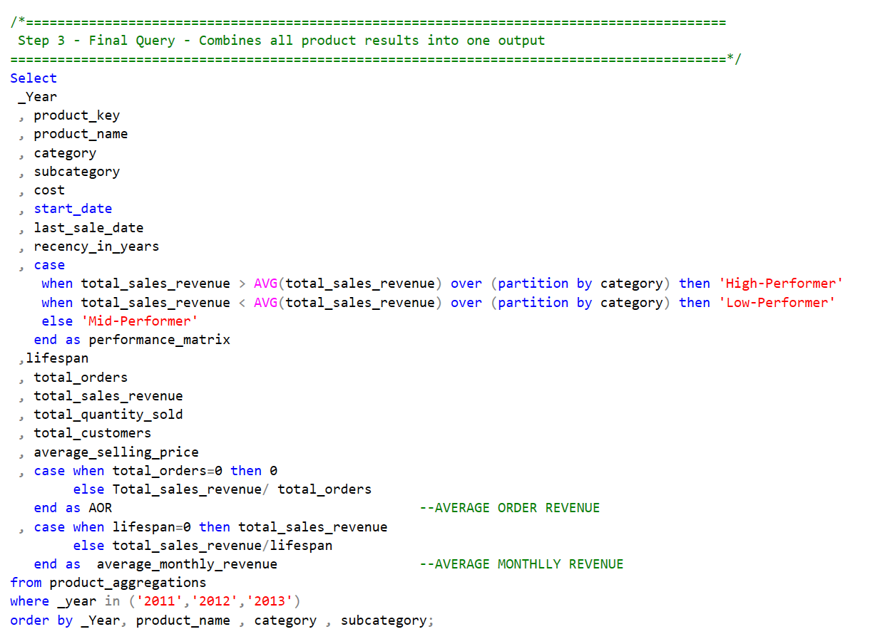
Task 2- Approach
In the final query, product performance analysis report has been generated carefully including all metrices requested for the report.
This step includes:
Classify each product as a High-Performer, Low-Performer, or Mid-Performer based on their total sales revenue relative to the average sales revenue in their category. This classification is achieved through a CASE statement using the AVG() window function to compare each product’s sales revenue to the category's average.
Calculate the Average Order Revenue (AOR): This is the average sales revenue per order for each product. It's calculated as total sales revenue divided by the total number of orders.
Calculate the Average Monthly Revenue: This is the total sales revenue divided by the product's lifespan (in months), giving insight into the consistent monthly revenue generation of each product.

Slide 23
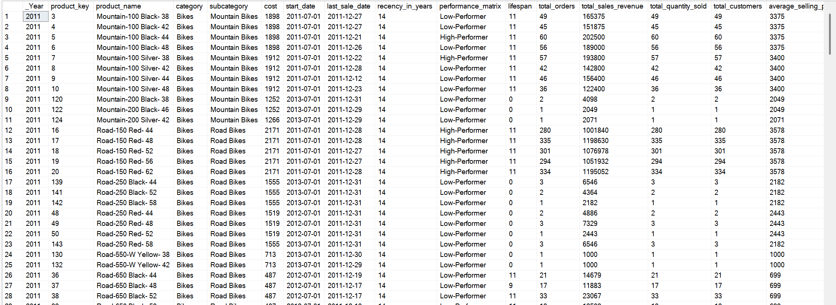
Task 2 - Final Output
The final output of the first report can be saved as csv to be used in visualization tools such as PowerBI or Tableau.
Alternatively, a view can be created for the relevant team who is responsible for monitoring this data month-on-month and year-On-year for strategic decision making.

Slide 24
Summary – Key Learnings
The presentation focuses on using SQL Server to analyze sales and customer data to generate reports that can drive business decisions. It covers essential SQL concepts and demonstrates how to apply them in practical reporting scenarios.
Key SQL Concepts and Techniques:
Common Table Expressions (CTEs): Used to break down complex queries into logical, manageable steps.
Data Aggregation: Demonstrated how to aggregate data using functions like COUNT, SUM, AVG, and MAX to calculate key metrics.
Window Functions: The AVG() window function is used to compare product sales within their categories.
CASE Statements: Used for data segmentation and categorization, such as classifying customers or products based on specific criteria.
Date Functions: The DATEDIFF function is used to calculate time spans like customer lifespan and recency.
Data Transformation: The presentation highlights the use of SQL to transform raw data into meaningful metrics and reports.
Types of Analysis: The presentation covers several types of data analysis:
Trend & Seasonality Analysis: Analyzing sales patterns over time to identify trends and seasonal fluctuations.
Performance Analysis: Comparing current data with target values or previous periods to evaluate performance.
Market Share & Contribution Analysis: Identifying the contribution of different categories or segments to overall sales.
Data Segmentation: Categorizing data to uncover insights into customer preferences and product demand.

